Slide 1

Signal processing using graphs
Manuela Leal
Andres Rubiano

Slide 2

Introduction

Slide 3
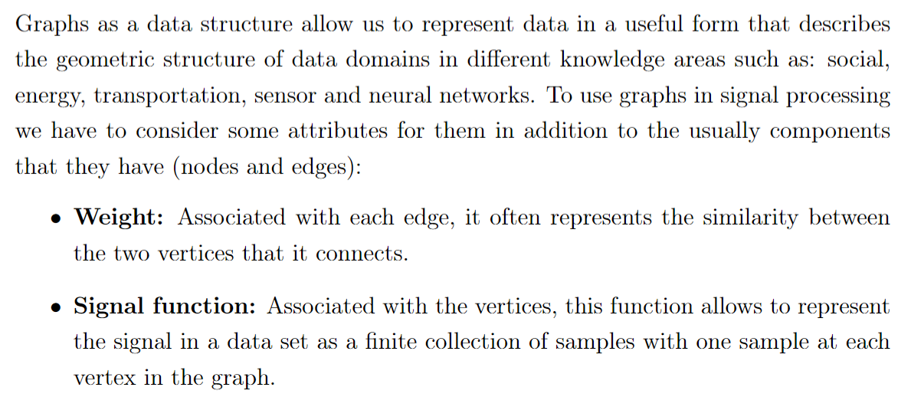
Graphs

Slide 4
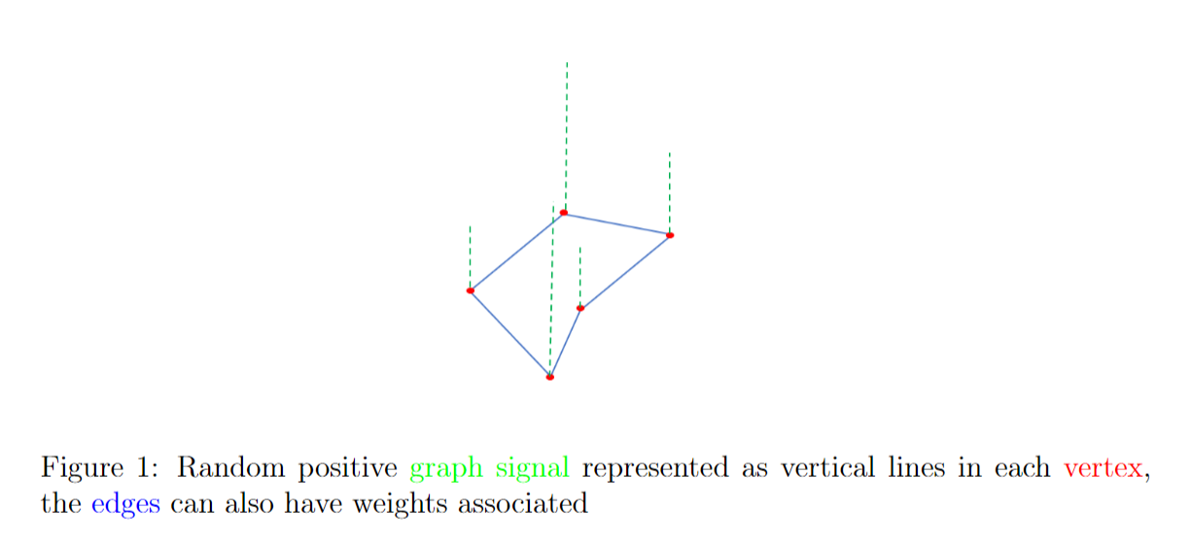
Example of a graph signal

Slide 5
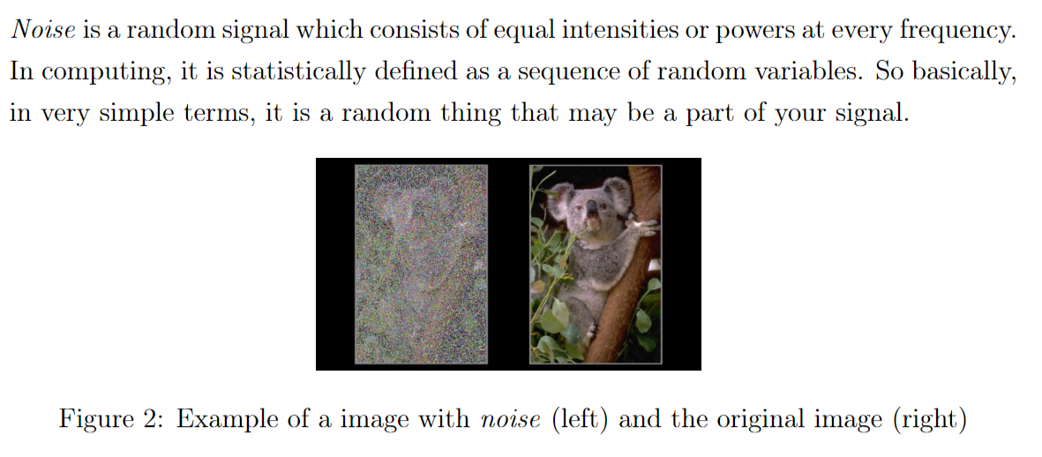
Problem: Noise in signals

Slide 6

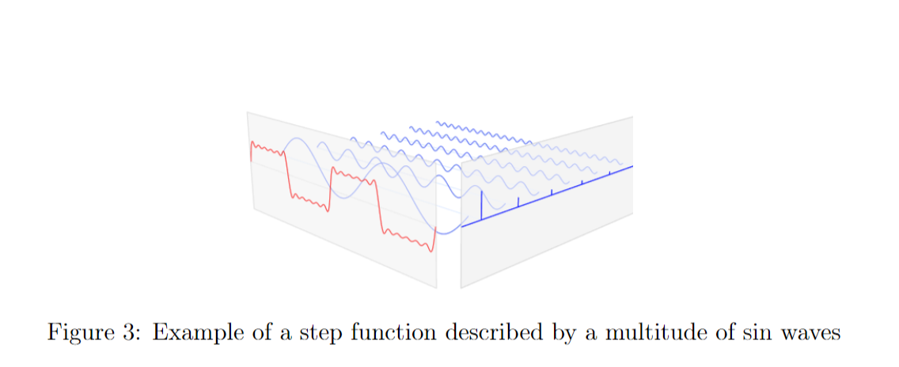
The Fourier Transform

Slide 7
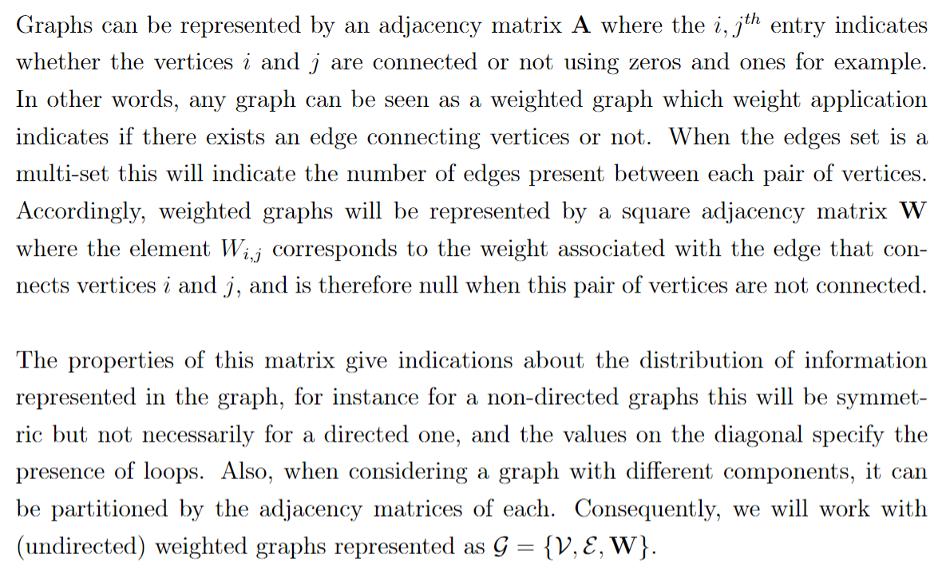
Weighted graphs

Slide 8
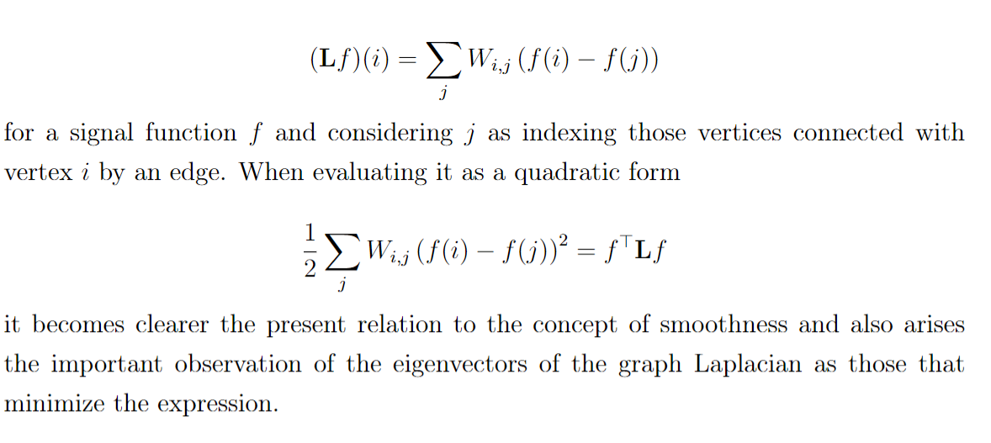
Graph Laplacian operator

Slide 9
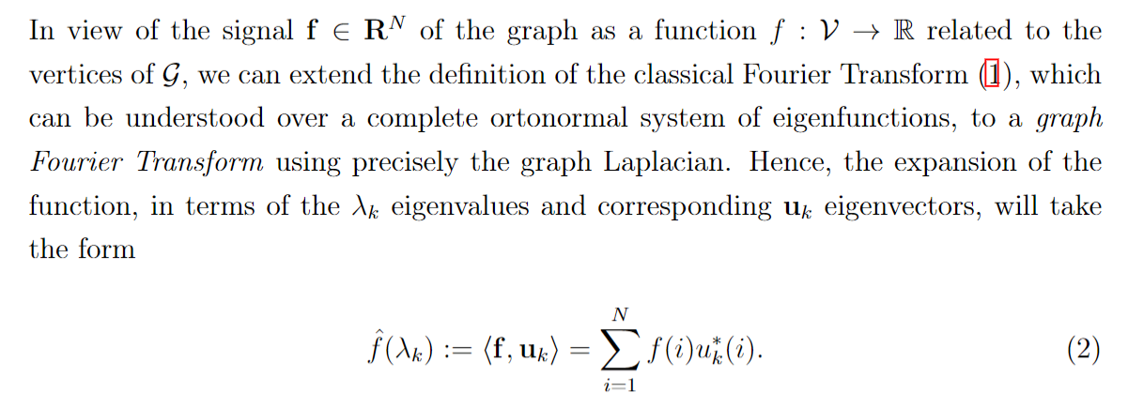
Graph Fourier transform

Slide 10
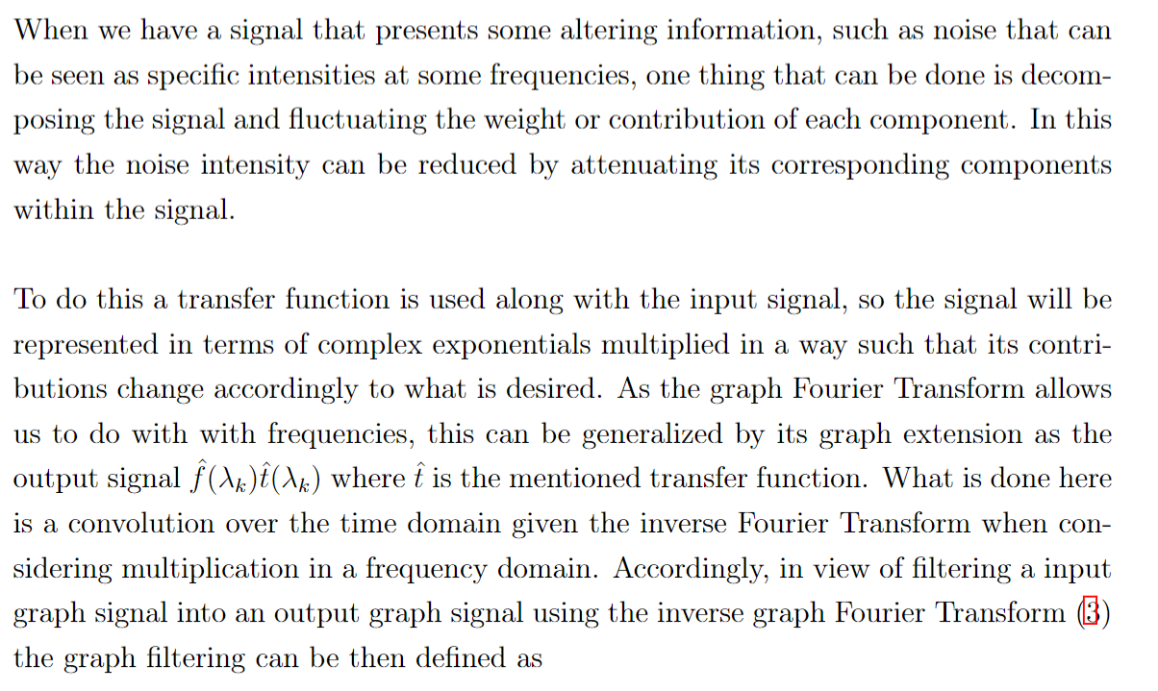
Filtering

Slide 11
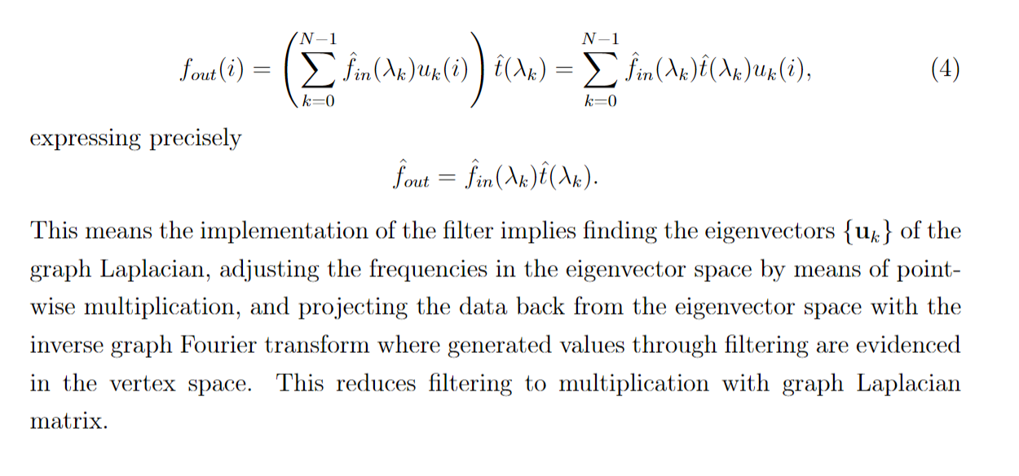
Filtering

Slide 12
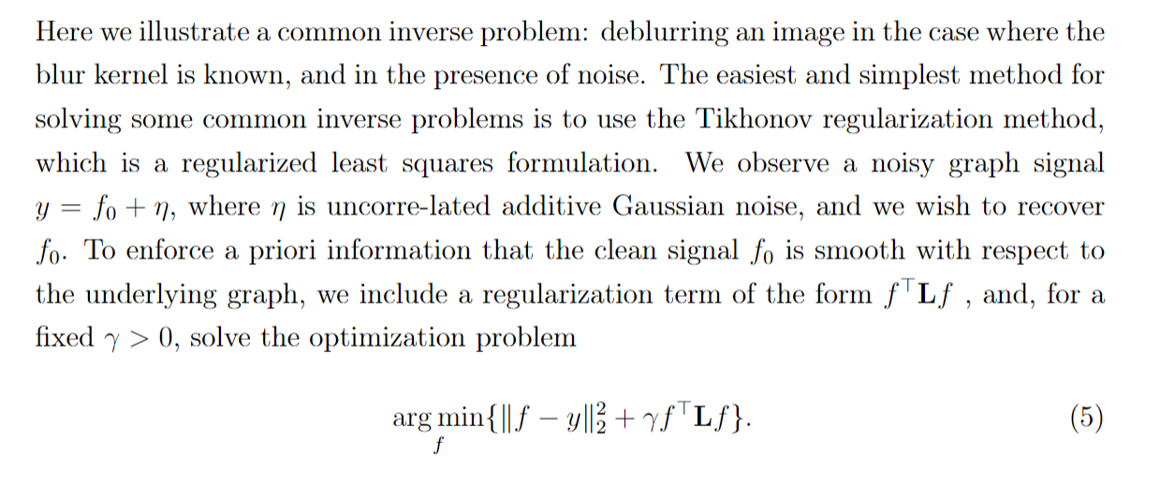
Tikhonov regularization

Slide 13
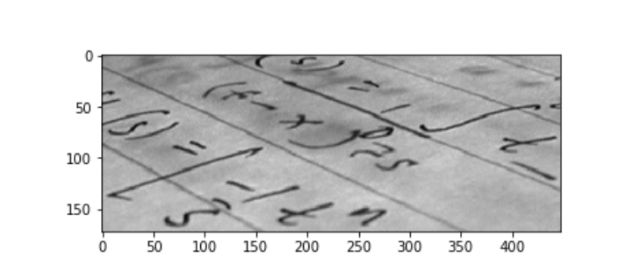
Example

Slide 14
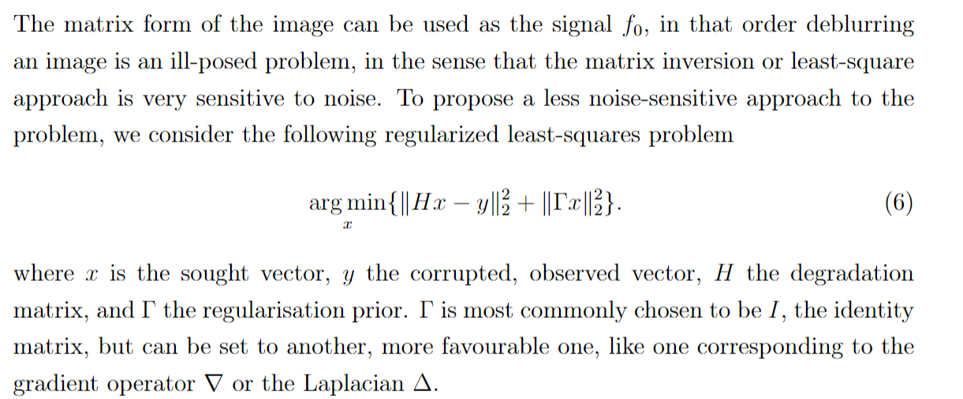
Matrix form of regularization

Slide 15


Use explicit solution

Slide 16
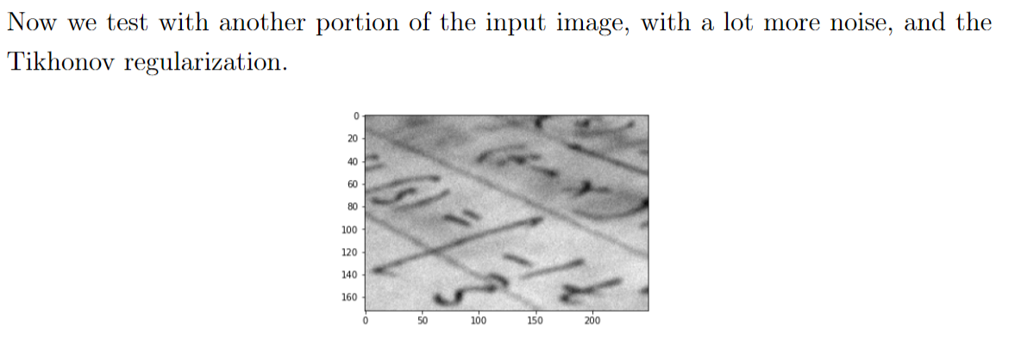
Input a noisily image

Slide 17
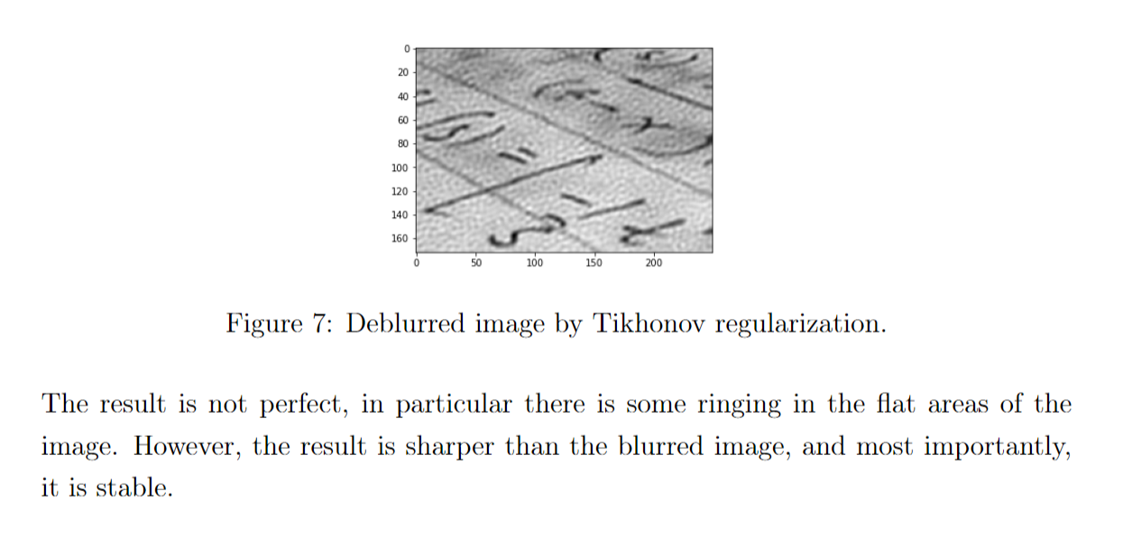
Solution

Slide 18

Conclusions

Slide 19
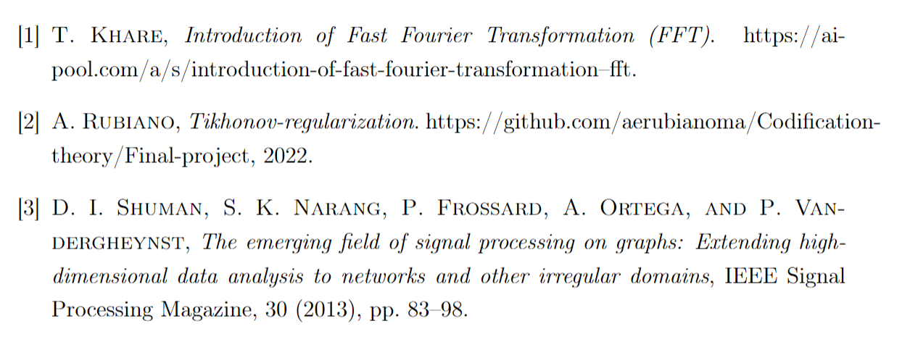

References

